Slide 1

Final Project:
F1 Racing & Possums
Meadow Monticello & Kevin Scott

Slide 2
TABLE OF CONTENTS
01
FINDING DATA
03
DEBUGGING
02
WRITING
04
CONCLUSIONS
How did we find our data. What did we decide on.
What were our difficulties during the process. Any errors.
What does our code look like.
Takeaways from the methods used. What we discovered about our data.

Slide 3

Part I.
Comparison of Machine Learning Methods for Classification

Slide 4

01
Finding Data
Kaggle was our main tool! Tags helped us find a data set good for classification. Ultimately, we chose F1 Drivers Churn Prediction.
Notes:
meadow : It features stats of Formula 1 (F1) drivers, and the data includes metrics on race performance, team participation, and time on the track. The data was collected most likely due to its usefulness in understanding career trends, overall driver behavior, and corresponding general race performance.
For our use of the data, we created a classification problem with our target
variable set to ‘idDriver’, a categorical variable representing the name of each F1 driver. Note idDriver is nominal. Another nominal categorical variable in our dataset is ‘idTeam,’ but we thought it would make the prediction too accurate without having to utilize and train the other features. For this reason, ‘idTeam’ was not included The features used to predict this variable are: ‘avgGridPosition', 'avgPosition', 'avgPositionLift', 'pctPolePositition', and 'pctPolewin'. All of these are numeric, continuous variables, representing either average or percentage values denoted from a numerous race outcomes. Of the data set, we chose to keep the previously listed features (means and percentages) and excluded medians and quantities as those would be redundant if ran with mean and percentages (respectively).
Overall, the dataset is balanced and includes information from the last five races.
Additional Variable Breakdown:
idDriver: Unique identifier for each Formula 1 driver, used as the target class in classification.
avgGridPosition: Average starting position on the grid.
avgPosition: Average finishing position.
avgPositionLift: Average positions gained per race.
pctPolePosition: Percentage of races started from pole position.
pctPolewin: Number of wins secured from pole position.
Formula 1 Terminology:
Grid position: The starting position of a driver in a race. Drivers start on a section of the track called grid in rows.
Pole Position: The first starting position in the grid.

Slide 5
02
Writing Code
HW and notes were our primary tools.
Let’s take a look at some of our code.

Slide 6
03
Debugging
Fairly smooth process
Semicolon separated dataset rather than comma separated→ had to change from standard procedure

Slide 7
04
Conclusions
k -nearest neighbors had best accuracy on test set, but support-vector classifier had best on training set
Worst accuracy (by far) MLP classifier
  All other methods had around 85-90%

Slide 8
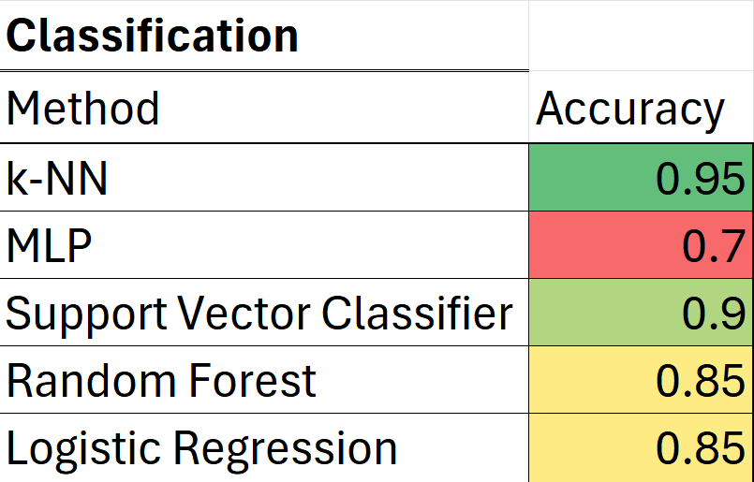
04
Conclusions (Table)

Slide 9

Part 2.
Comparison of Machine Learning Methods for Regression

Slide 10

01
Finding Data
Kaggle was our main tool! Tags helped us find a data set good for regression. Ultimately, we chose Possum Regression
Notes:
meadow : It contains measurements on 104 mountain brushtrail possums collected from seven locations across Australia, ranging from Southern Victoria to Central Queensland. Each record includes nine morphometric features (e.g. head length, tail length, and body weight) along with categorical information like sex and site location. The dataset was originally designed to explore relationships between biological traits and geographic variation, making it ideal for both statistical modeling and machine learning demonstrations.
In our project, we use this dataset to showcase machine learning methods for regression, with the goal of predicting the target variable totlngth (total length). The features include both numeric variables (e.g. hdlength, skullw, totlngth, taill, footlgth, earconch, eye, chest, belly) and categorical variables (e.g. sex, pop). Among the categorical variables, sex is nominal (male or female) and so is pop (‘Vic’ for Victoria or ‘other’ for New South Wales or Queensland). The data was fairly comprehensive. However, there were a couple missing values which we imputed using the means. For instance, there were two missing values on ‘age’ and one missing value on foot length. Minimal data cleaning was needed beyond this. This data is relatively balanced and compact, making it suitable for testing different regression models, evaluating feature importance, and comparing model performance with real-world biological data.

Slide 11
02
Writing Code
HW and notes were our primary tools.
Office hours helped too!

Slide 12
Debugging
03
Much more troublesome than classification
Almost line had to be altered and reran at least once
Specific problem areas:
  One Hot Encoding test and training set
  Class examples had to be modified to correspond with One Hot Encoder
  “Too many values to unpack” in MLP regression

Slide 13
04
Conclusions
Best test RMSE was from support vector regressor (0.3128)
Worst RMSE was from MLP regression (0.608)
Notes:
Meadow

Slide 14
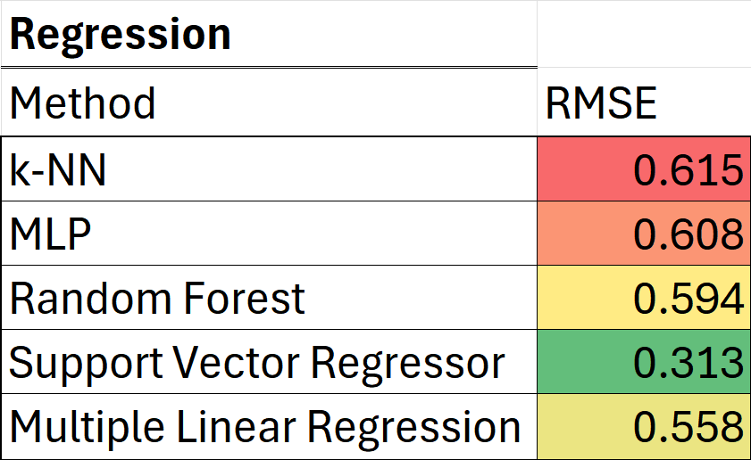
04
Conclusions (Table)

Slide 15
THANKS
DO YOU HAVE
ANY QUESTIONS?

